Slide 1
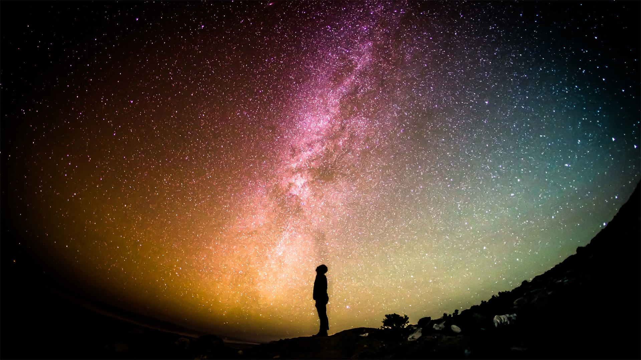
Responsible lighting and protecting the night sky: updating the NM Night Sky Protection Act
Jon Holtzman
Chair, State Council, NM DarkSky

Slide 2
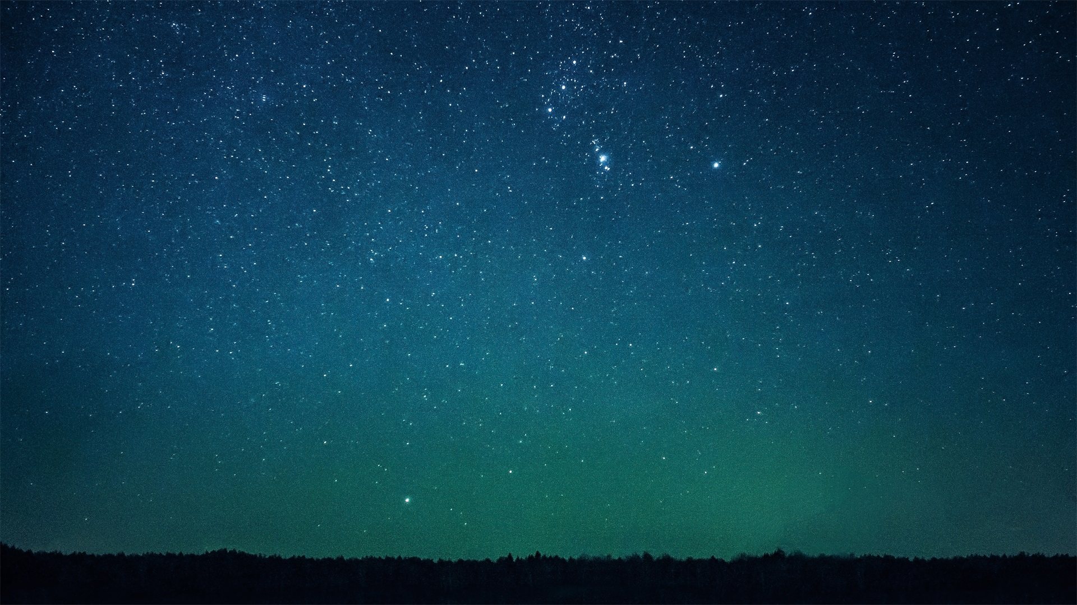
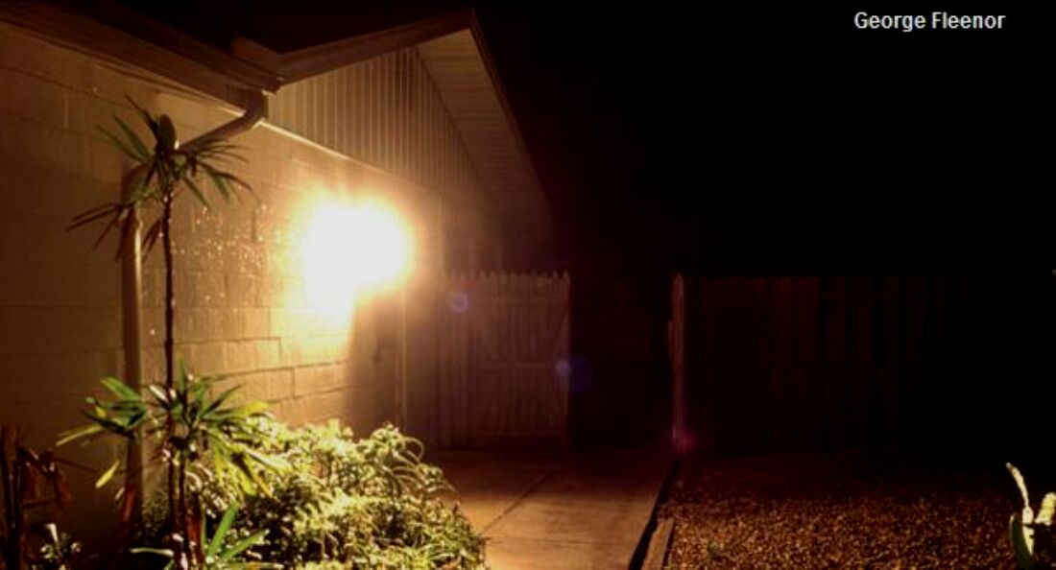
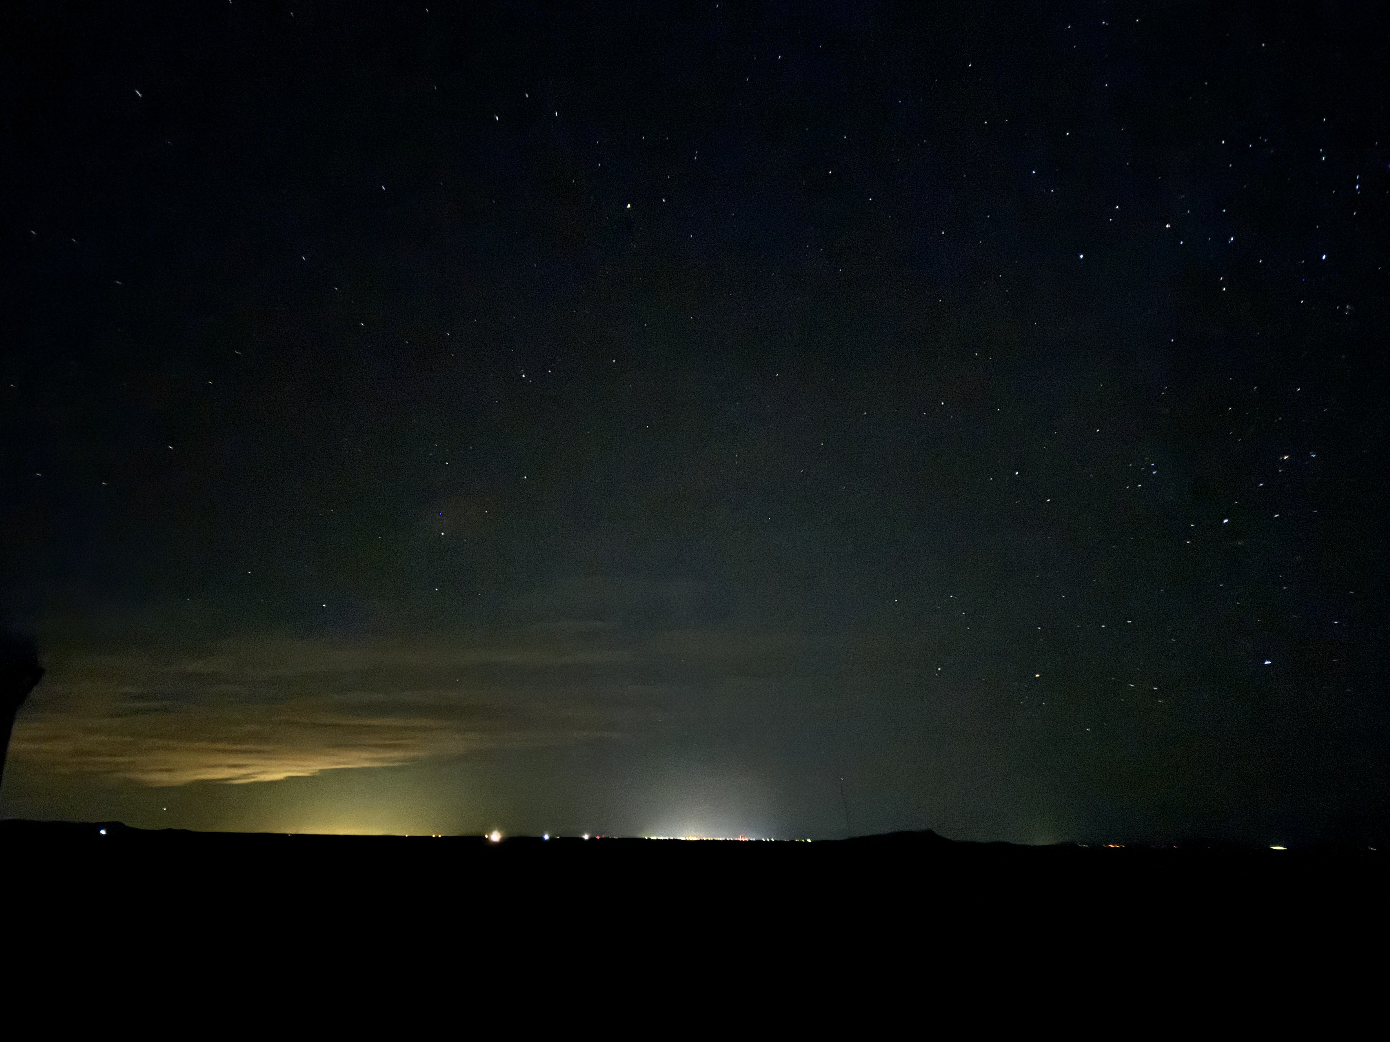
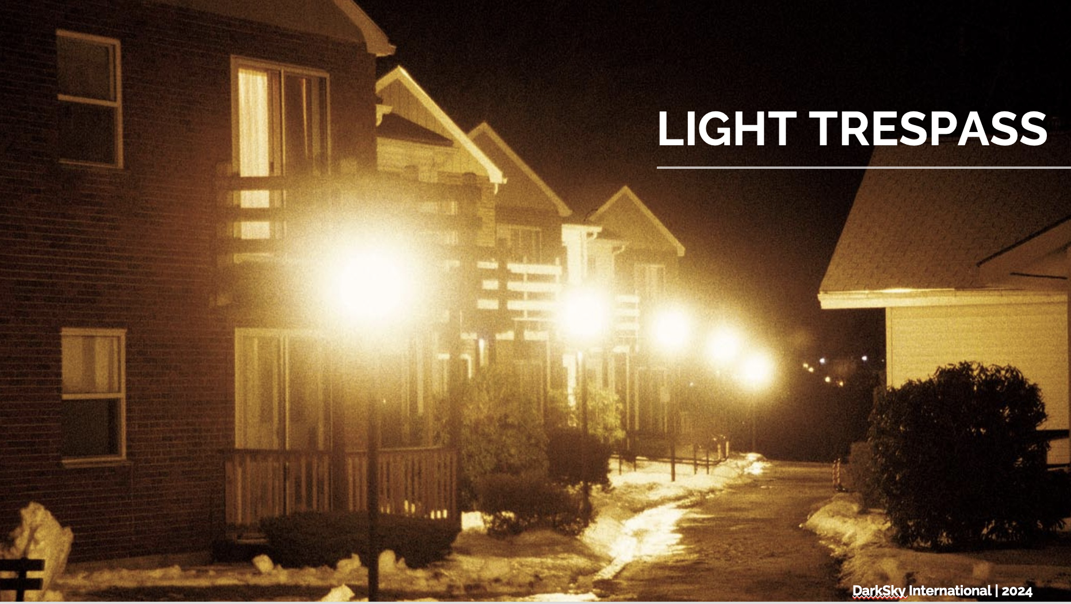
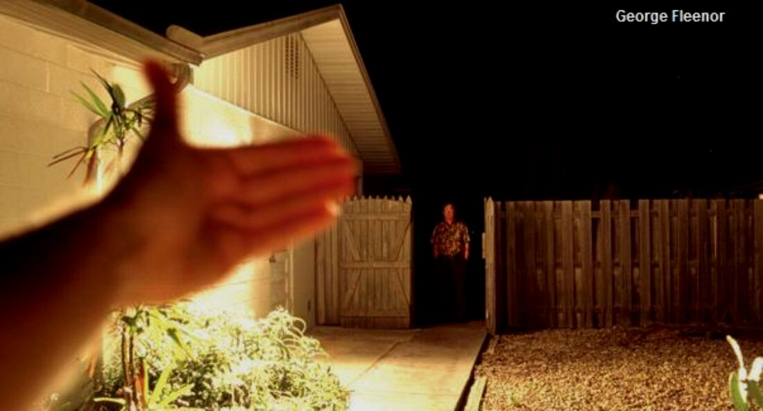
What do we mean by responsible lighting?
Put light only where you need it, when you need it, and only in the amount that is needed
Use redder light (lower color temperature)
Responsible lighting reduces:
Sky glow
Glare
Light trespass
GLARE
SKYGLOW

Slide 3
Values of responsible lighting and a natural night sky
A valuable natural resource : NM has something special!
Economic impact : tourism, residential communities, small businesses
Worker safety : responsible lighting can be safer than excess lighting
Security : responsible lighting can provide greater security
National security : satellite tracking and monitoring, monitoring of near-Earth asteroids
Human health : sleep better!
Ecological benefits: pollinators and migratory birds are adversely affected by poor lighting
Energy and money savings : less wasted light, less wasted energy, more savings!
Respecting property rights : property owners have right to protect against light trespass
Human appreciation of our place in the Universe
Cultural resource : multiple cultures have connections with the night sky
Scientific study : all three research universities have programs, with several major observatories
Amateur astronomy : widespread interest, multiple amateur societies across the state

Slide 4
New Mexico DarkSky
Chapter formed in 2023 in response to effort from DarkSky International
> 100 members in the state
Activities led by State Council
Chapter initiatives / committees
Legislation/ordinances
Education/outreach/engagement
DarkSky places
Economic impact
Resources : nmdarksky.org web site

Slide 5
Widespread interest in dark skies
Stakeholder meeting in December 2023 attracted interest from many perspectives:
DarkSky International and NM Chapter
Illuminating Engineering Society
Xerces Foundation
NM Biopark
Mesilla Valley Audubon
Carroll Petrie Foundation
New Mexico Wilderness Alliance
Wilderness Society
Santa Fe Conservation Trust
Apache Point Observatory / NMSU
New Mexico Tech
Very Large Array
NM True
NM State Land Office
BLM
National Park Service
Bandalier National Monument
New Mexico Oil and Gas Association
Starfire Optical Range
Albuquerque Astronomical Society
Magdalena Astronomical Society
Warehouse I-10 At Gallery
Santa Fe New Mexican

Slide 6
Why revise the Night Sky Protection Act (NSPA)?
NM was a pioneer, passing the NSPA in 1999
Required new lighting to be shielded
Included several notable exceptions/exemptions
Much has changed since 1999
New technology : LEDs!
More appreciation of the importance of natural night skies
More appreciation of the value of responsible lighting
More appreciation of the value of astrotourism
Recognition that enforcement is a challenge
Our dark skies are disappearing as artificial light at night has continued to bleed across the state

Slide 7
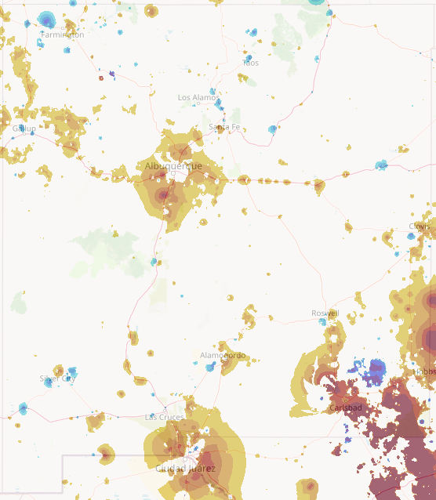
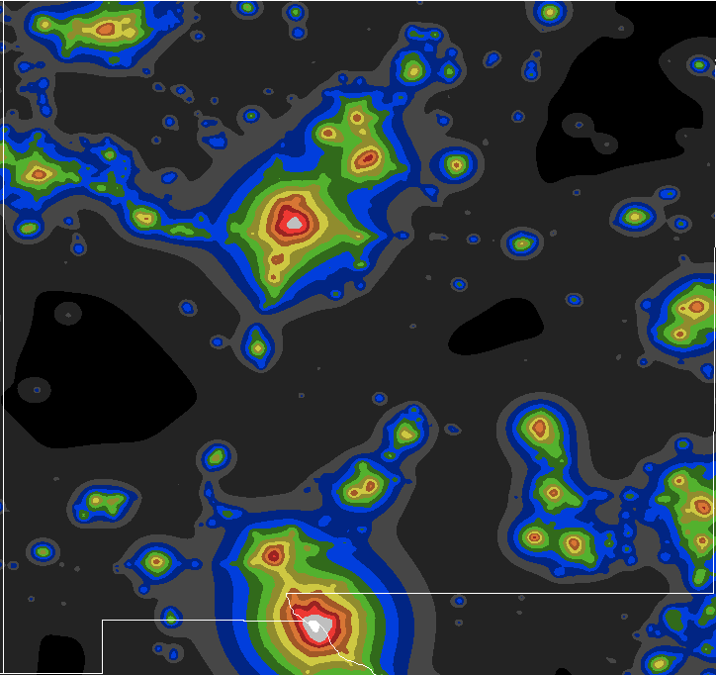
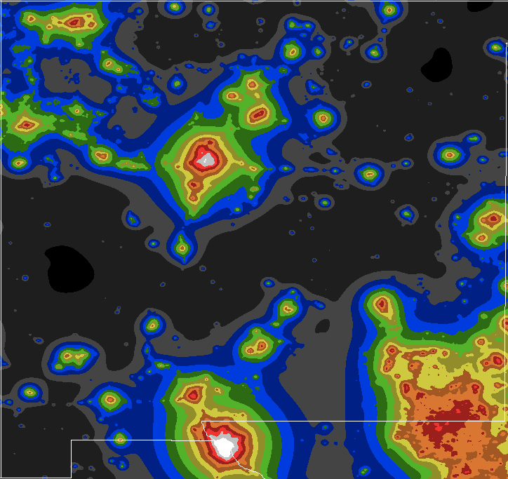
ALAN change
2006 artificial light at night (ALAN)
2022 Artificial light at night
https://djlorenz.github.io/astronomy

Slide 8
Proposed revisions : stop the bleeding!
Revise the definition of shielding :
Restrict light to 80 degrees from straight down (nadir), instead of 90 degrees
Revise technical description of what lighting is exempt: don’t specify using (inappropriate) watts
Require all new lighting to be shielded per new definition, except for low light fixtures < 1000 lumens
Existing lighting does not need to be changed, but existing non-conforming lighting is required to be extinguished by 11:00pm if not on an auto-shutoff (unless exempt, see below)
Modify exemptions as follows
Remove exemption for highway advertising (but not navigation)
For farms, ranches, dairies, feedlots or industrial, mining or oil and gas facilities
Require new construction to comply but extend start date for this requirement to 2027 : no disruption for work in progress
Maintain FULL exemption for existing lighting : don’t require existing lighting to be extinguished after 11:00pm
Add exemption for temporary lighting related to film and television production

Slide 9
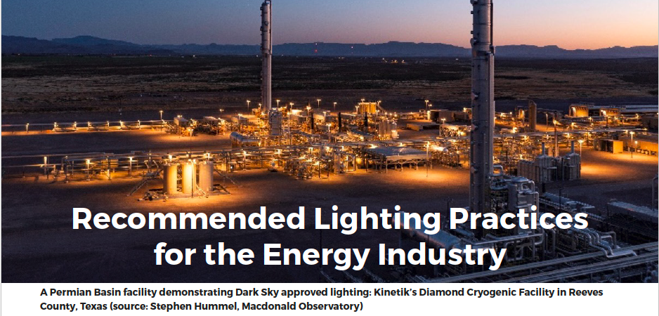
Responsible lighting is achievable and has positive impact
“Consistent with our core values, HEP is always looking for ways to be a good steward of our environment and to give back to the communities where we live and work. The Dark Skies program not only helps us achieve this goal, but also makes the facility safer” --Jarrell Shircliff, Director of Operations for Howard Energy Partners
“
“You get the right kind of lights and space them out in the right way and it’s actually better lit up. There’s fewer dark spots, you don’t have guys tripping over stuff” -- Chris Gafford, safety manager at Callon Petroleum
“The employees love it! One commented that he could actually see the equipment and where he was walking now” – Olivia McNamara, Manager HSE, WPX Energy

Slide 10
Q&A and Discussion
Current status
We want to address concerns and enlist support!
State legislation is only one part of enacting meaningful change
Local legislation can be more specific and stringent (but not less)
Education about positive effects of responsible lighting is critical
Cultural shift is needed
Demonstration of broad-based support at the state level can be very impactful

